Slide 1
Working with SPOT
Niraj Kishor Ladhe
Abhishek Dilip Patil

Slide 2

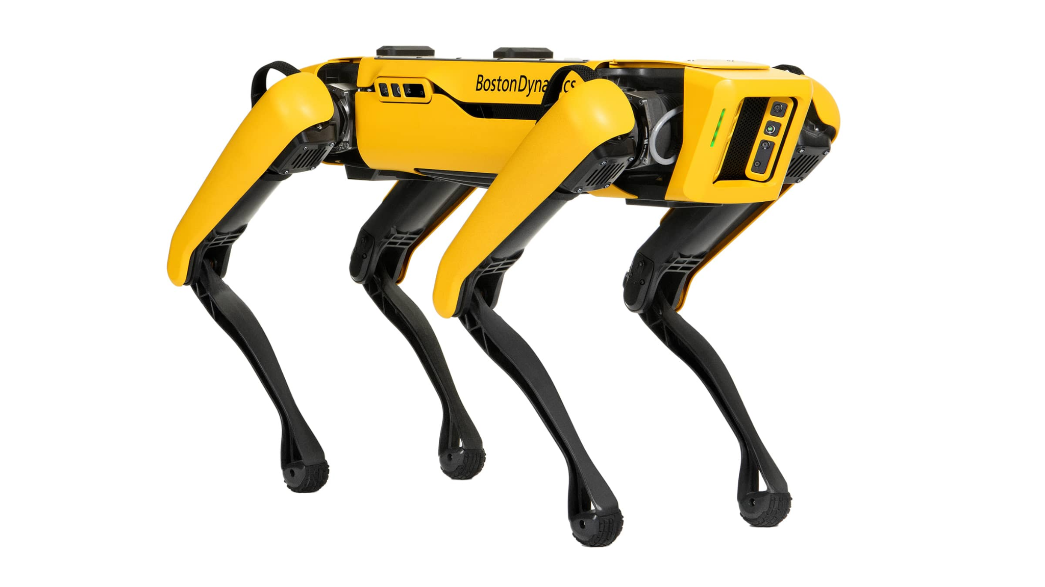
Goals
Detect AprilTags using onboard cameras and Follow the AprilTags on user command

Slide 3
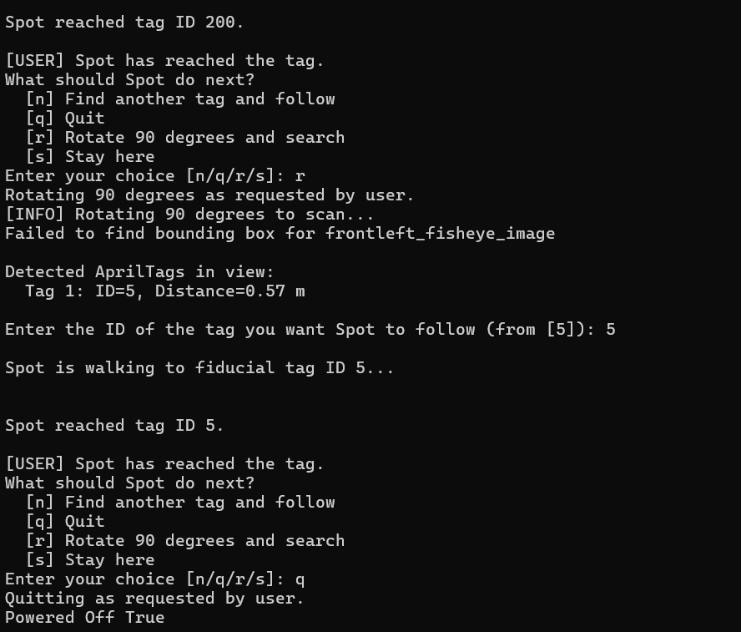
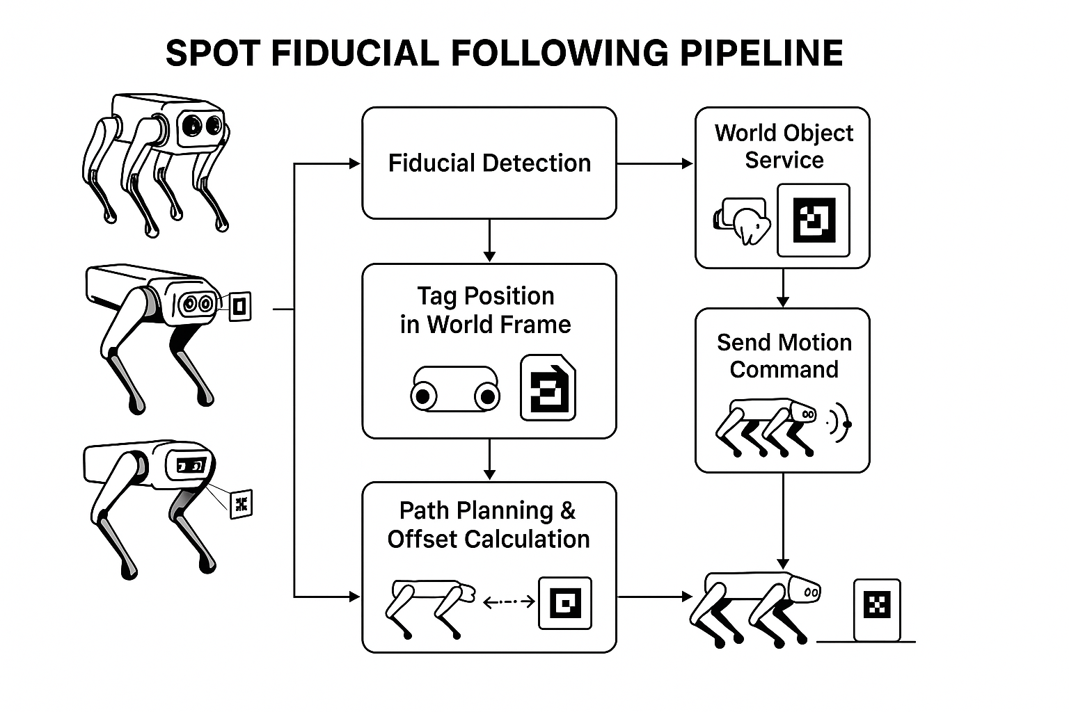
April-tag follow command
Basic fiducial detection code
Basic detection of April-tags in cameras.
Displaying visible April-tags seen to user
Adding more user inputs
Finding another tag and following it
Standing SPOT once April-tag detected.
Detecting all the tags visible
Showing all the tags visible in the cmd window.
Displaying the cameras
Showing the live feed of all the cameras
Warning: The code has crashed when the camera feed is given to the client.
Moving robot such that the front-right camera is aligned to the fiducial
Quit option
Rotating 90 degrees and search
Staying at the same place
And printing more info in the cmd window
Changing the distance margin and the speed
Camera capture
The images from all cameras are captured when client gives the command.
Flowchart showing the development process in making a April-tag follow

Slide 4

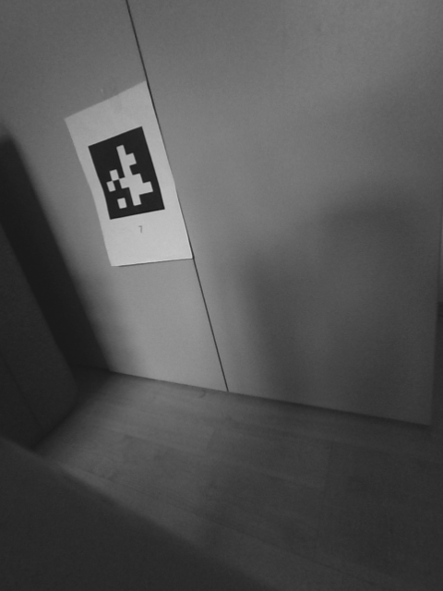
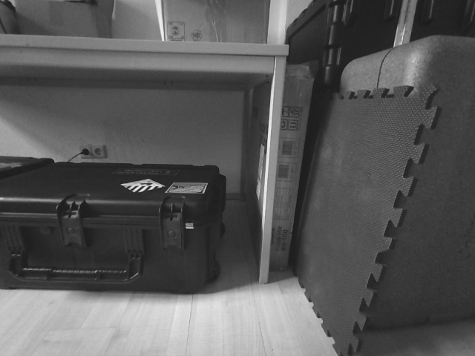
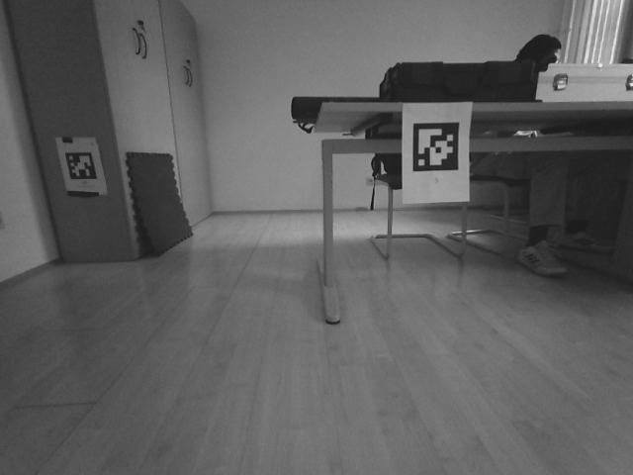
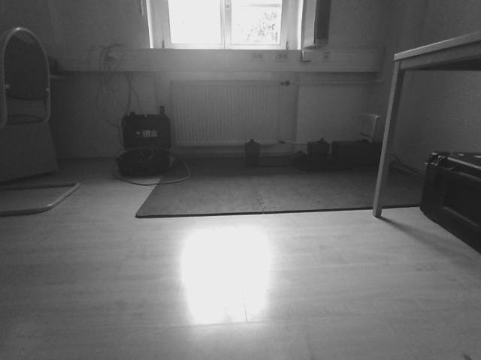
Front left
Front right
Left
Right
Back

Slide 5
Next Step!
Combining some features of WASD or Xbox controller code with the fiducial follow.

Slide 6
Git repository link:
https://github.com/abhishekdilippatil/spot-sdk.git

